Slide 1
Lifestyle changes
Cornerstone in PCOS management
Dr. A V Bharathi Phd
Weight loss consultant

Slide 2
PCOS - BASICS
Prevalence in India is 11%
Endocrine disorder
Metabolic disorder
Reproductive age women
Heterogeneous condition

Slide 3
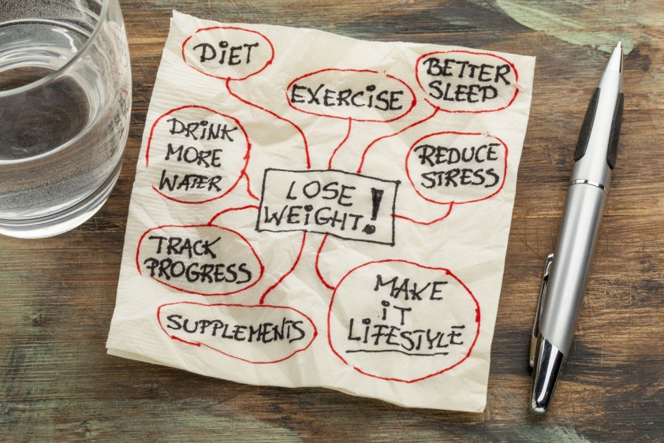
Lifestyle change
Physical activity
Body weight
Healthy diet patterns
Good sleep
Well being
Mental health

Slide 4
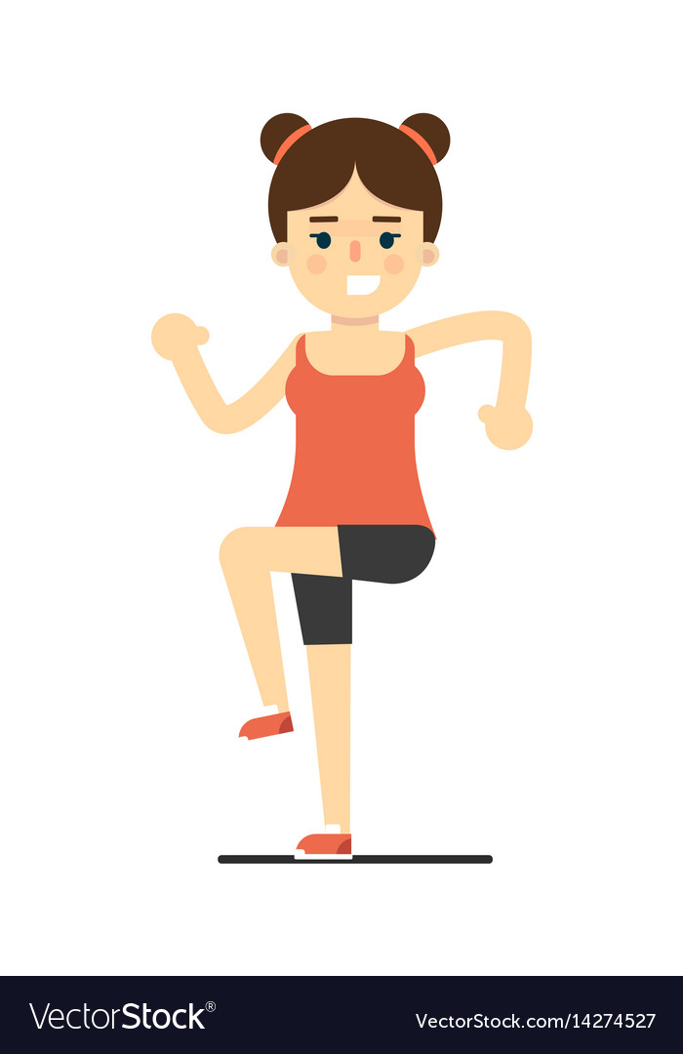
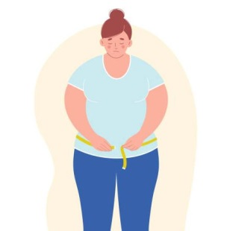
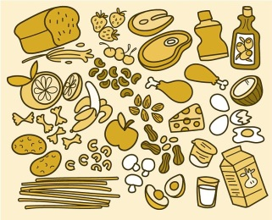

Transform
Excessive weight Poor diet
sedentary life
Positive change

Slide 5
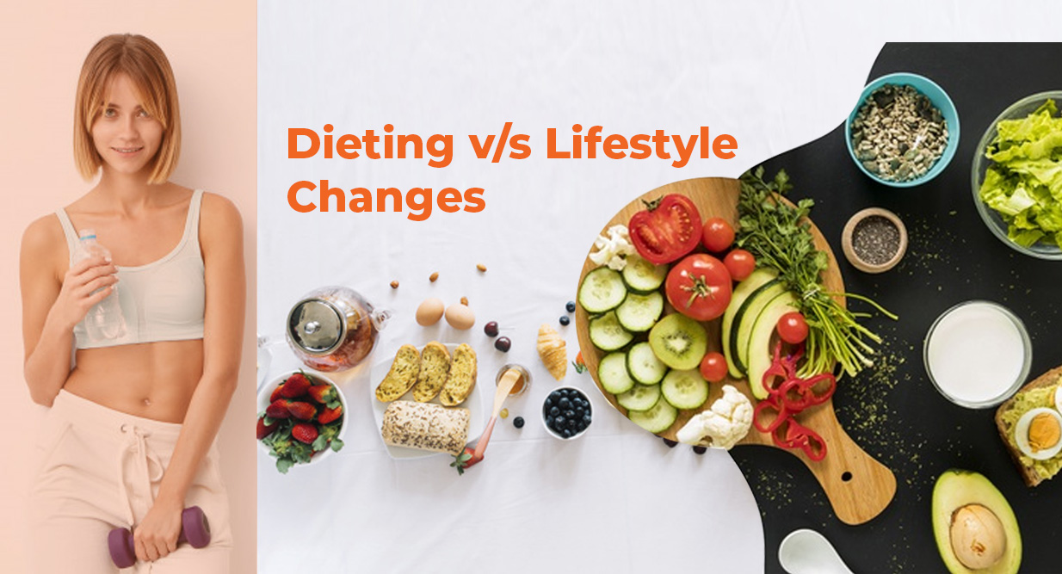

Slide 6
Lifestyle change
Physical activity
  Frequency / regular
  intensity
  Resistance exercise
Body weight
  Reduce body fat
  Increase muscle mass
Healthy diet patterns
  Reduce calories
  Increase proteins
  Improve satiety

Slide 7
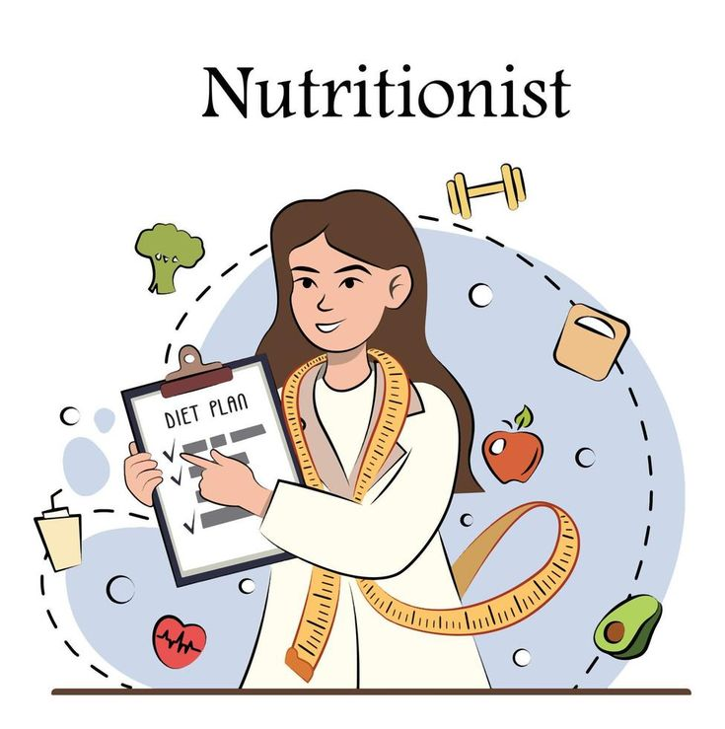


Lifestyle coach

Slide 8
Benefits of nutrition

Slide 9
Weight loss diets
Low glycemic Index diet
Low fat diet
Low calorie, low GI
Intermittent fasting
Ketogenic diet
Anti inflammatory diet

Slide 10
Low calorie diet with no weight loss
  insulin resistance
  Fasting insulin
  Lipid parameters(Total, LDL, cholesterol, triglycerides
  Weight , abdominal obesity,
  Total testestorone
Kazemi M., Hadi A., Pierson R.A., Lujan M.E., Zello G.A., Chilibeck P.D. Effects of Dietary Glycemic Index and Glycemic Load on Cardiometabolic and Reproductive Profiles in Women with Polycystic Ovary Syndrome: A Systematic Review and Meta-Analysis of Randomized Controlled Trials. Adv. Nutr. 2021;12:161–178. doi: 10.1093/advances/nmaa092.

Slide 11
Low calorie diet with physical activity and omega 3
Increased in HDL
Sex hormone binding globulin (SHBG) synthesis,
Body fat reduction

Slide 12
Other changes
Soluble fiber
  Short chain fatty acids in the gut
  reduced ghrelin and increased glucagon
High fructose diet
  Aggrevates endocrine changes
Ketogenic diet
  Weight loss
  Reduced blood sugars

Slide 13
Weight loss

Slide 14
Guidelines we follow
Calorie deficit of 500-750 kcal /day
300g-500gm weight loss / week
Stage 1: Modest weight loss of 3-5%
Cardio based exercise
Include strength training

Slide 15
General guide
Ascertain current lifestyle habits
Evaluate readiness to change
Prescribe a diet – current food habits
Set physical activity goals
Maintain a diary
Communication
Motivate – motivational interview

Slide 16
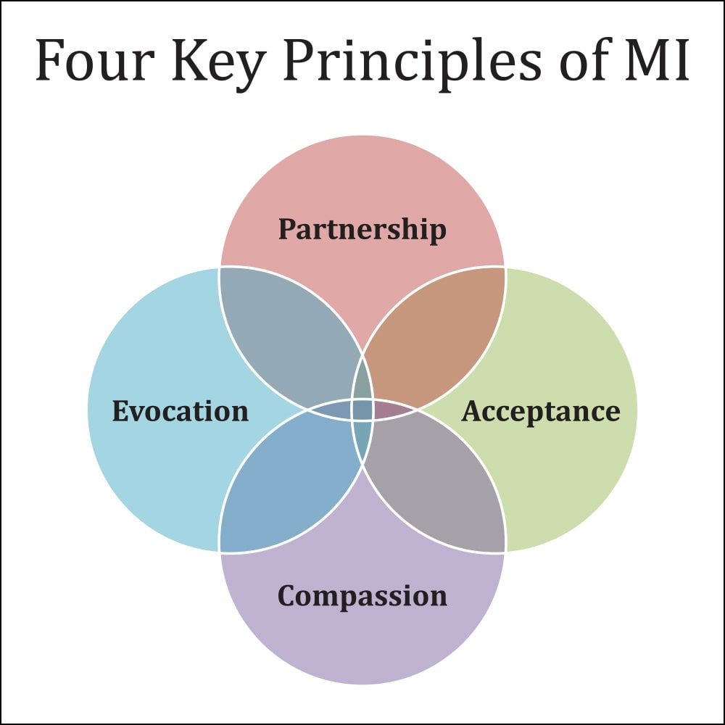
‘Spirit’ of MI
Collaboration
Acceptance
Evocation
Compassion

Slide 17
Principles of MI
Express empathy
Avoid argument
Support self-efficacy
Roll with resistance
Develop discrepancy.

Slide 18
Empathy
Express empathy
  Listen…listen…listen
  Respect their feelings
  Feel honestly
  limited facial disapprovals
  Less talking
  Reflective listening

Slide 19
Reflective listening
Listen
Acknowledge
Get thoughts /
Beliefs/data
I know, I understand
Summarize
Get meaning
Get feelings
You feel, You sound, you look like
You feel_____because____
You feel_____when______
You feel_____that _______

Slide 20
Change habits
Identify unhealthy behaviours
Identify barriers to change
Provide suggestions specific to barriers
Provide a step up planner for each modifier.
Eg: Fried snacks

Slide 21
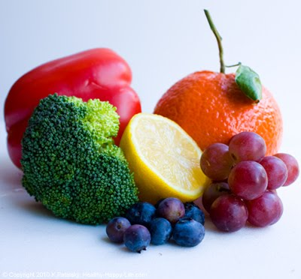
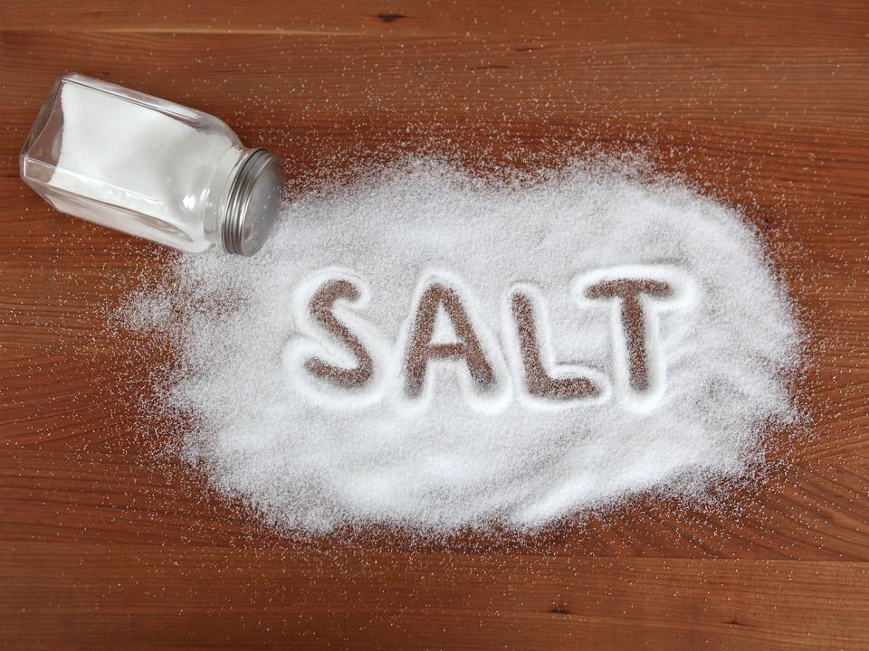
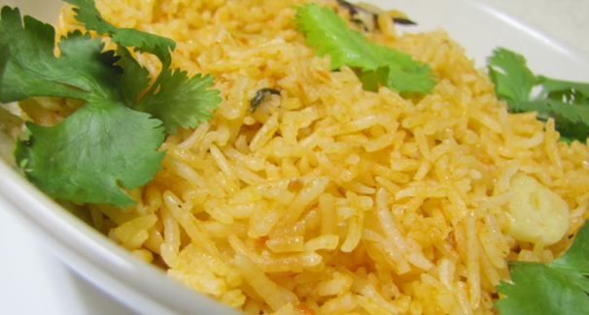

Food
Food groups
Fruits & vegetables sugar / salt
Carbohydrates Fats & oils

Slide 22
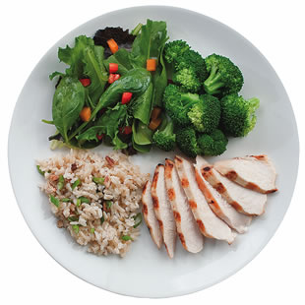
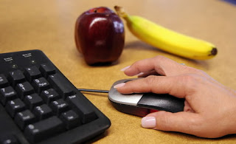
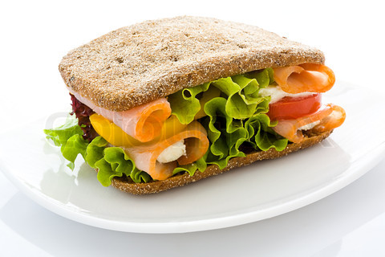
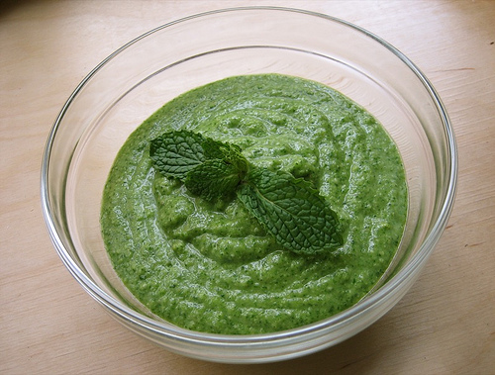
Low calorie inclusions
Work station fruit Meals with veggies
Salads with breakfast Veg chutney

Slide 23
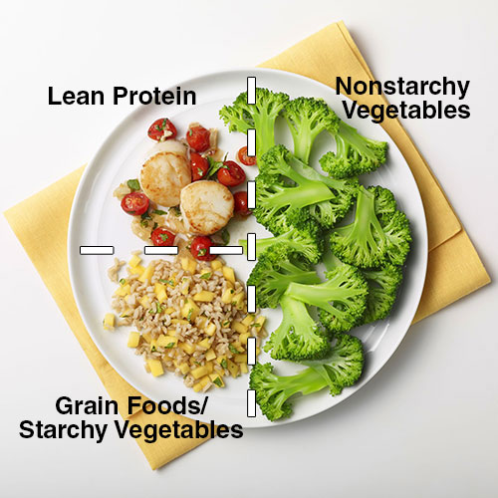
Visualize visualize visualize !!!

Slide 24
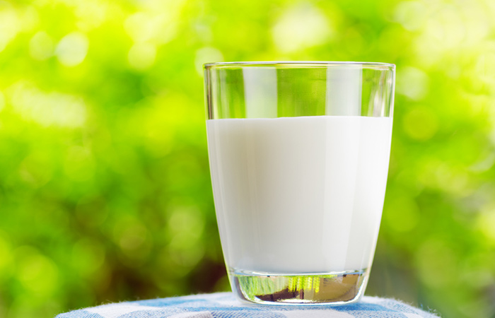
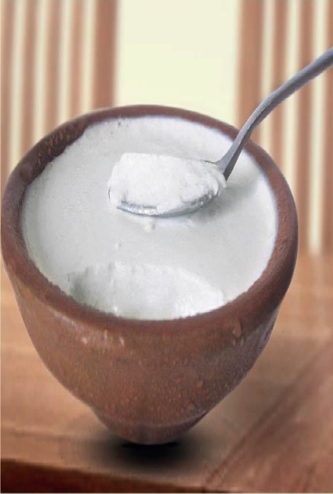
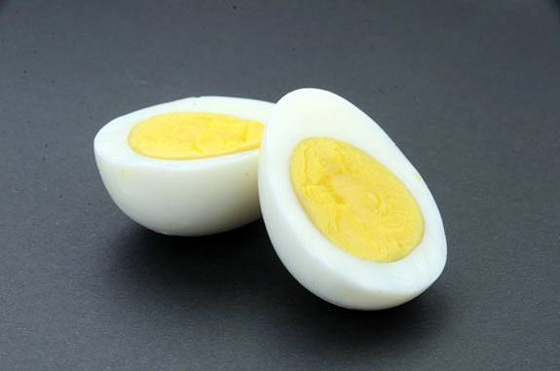
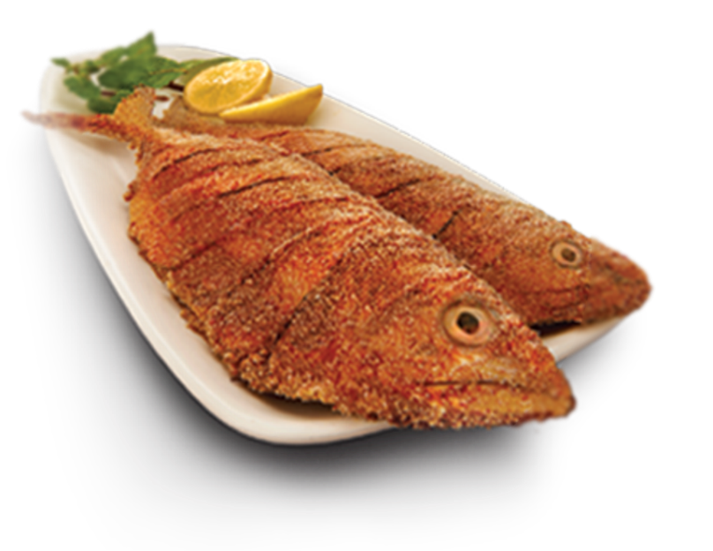
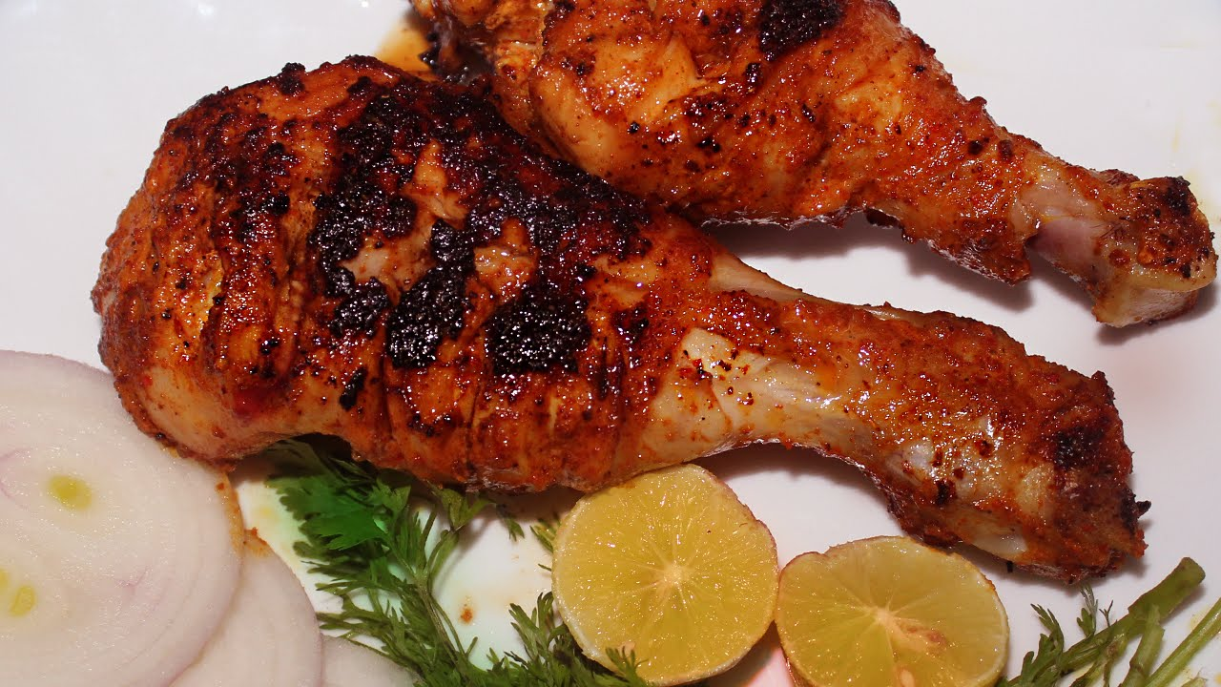

Choose low fat high quality protein foods
Egg whites daily
Milk
Curd
Steamed fish
Steamed chicken

Slide 25
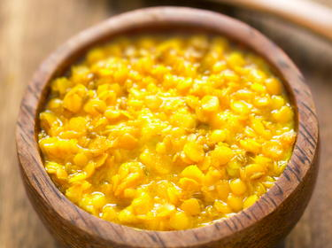
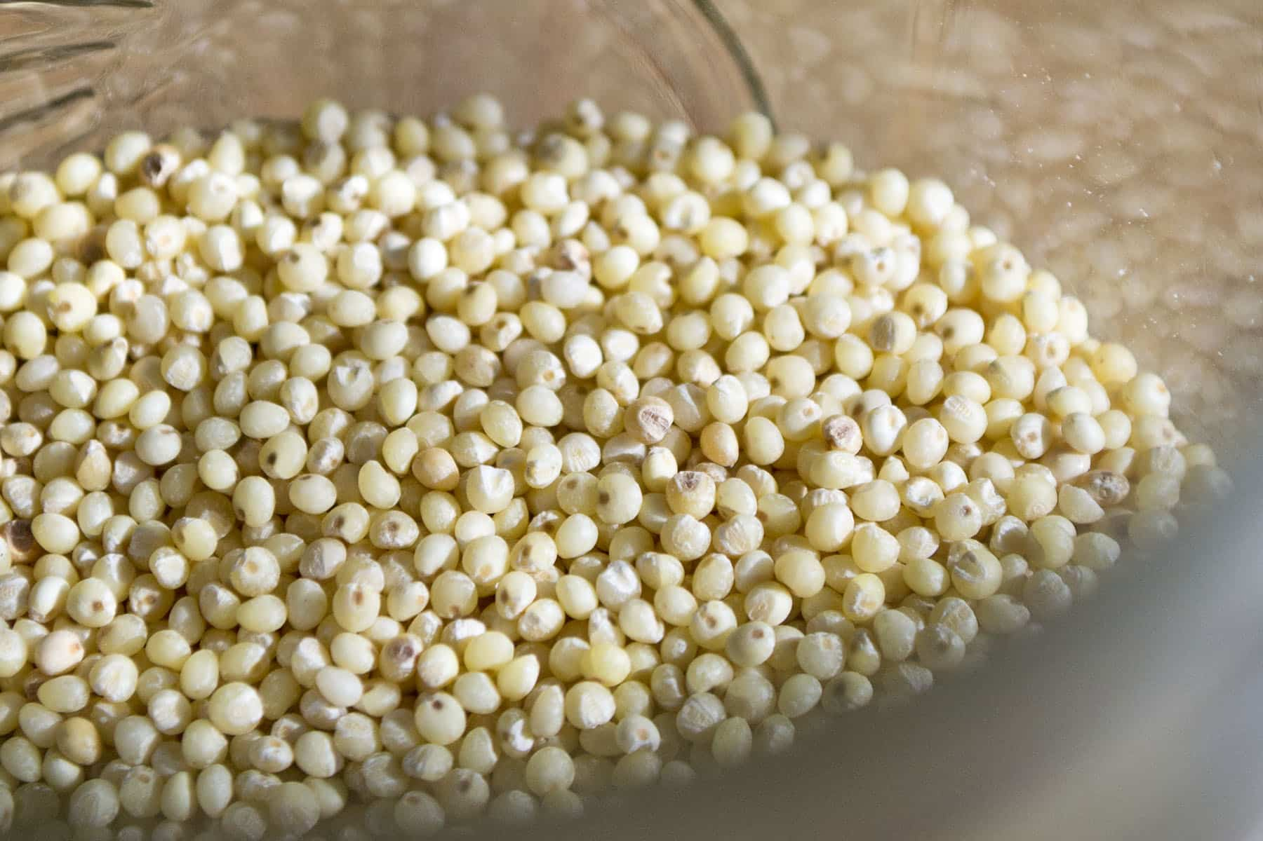
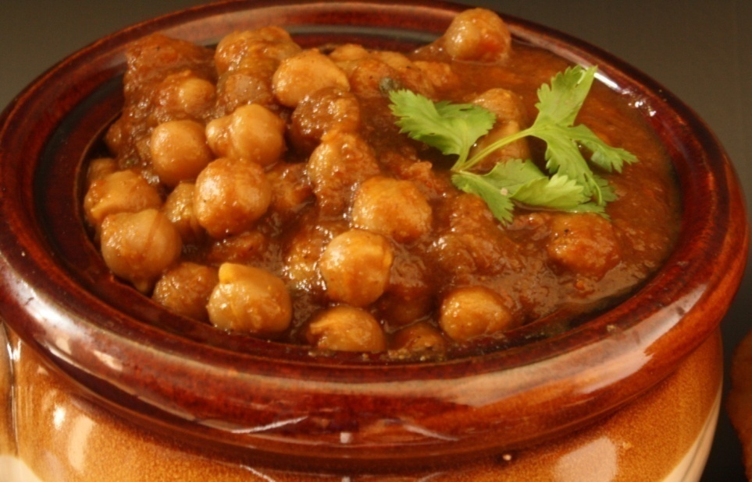
Vegetarian protein foods
Dhal
Nuts
Curd
Millets
Channa / rajma

Slide 26

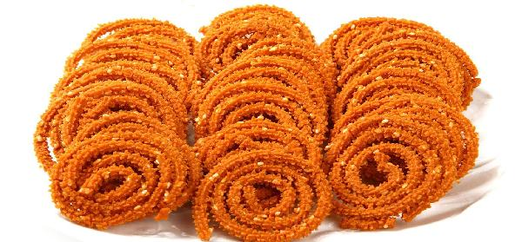

Watch out for fat in your diet!

Slide 27
My suggestions
Small changes
Replace tea biscuits with a fruits
Add 1 cup of salad daily
Increase your veggies at each meal
Add a low fat protein food
Reduce eating out episodes
Add 1-2 healthy foods each month
Watch your cooking oil consumption

Slide 28
Exercise
Type of exercise
intensity
Duration
Frequency
Strength training

Slide 29
Exercise
Set a time slot for exercise
Start with 2-3 sessions for 15 mins
Find joy in exercise
Match with resources
Positive mood booster

Slide 30
Conclusion
Benefits of low calorie diet without weight loss
Prepare them for long term change
Need to work with their barriers
A lifestyle coach OR weekly follow ups required
Emphasis on exercise essential
Positive living

Slide 31
Aim
A lifestyle change
  Not just diet change
  Not just including an exercise plan
        But
        A way of life

Slide 32
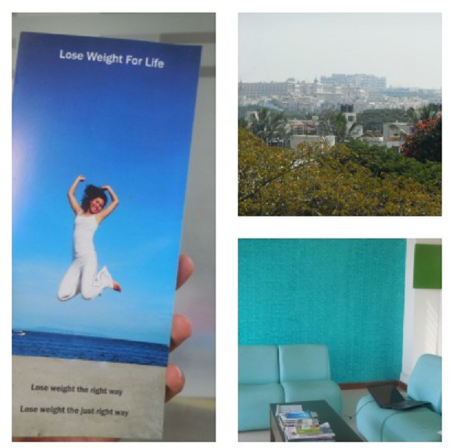
Thank you
Dr. Bharathi AV
Weight loss consultant

Slide 34
Impact of exercise
Weight loss
Body composition
Cardiorespiratory fitness
Insulin resistance

Slide 35
Supplementation
  Vitamin D
  Inositol (vitamin B-8)
  Folate/folic acid (vitamin B-9)
  B-group vitamins (B-1, B-6, B-12)
  Vitamin K
  Vitamin E
  Vitamin A
Nutritional Supplements and Complementary Therapies in Polycystic Ovary Syndrome.
Alesi S, Ee C, Moran LJ, Rao V, Mousa A.Adv Nutr. 2022 Aug 1;13(4):1243-1266. doi: 10.1093/advances/nmab141

Slide 36
Supplementaion
Zinc
Selenium
Magnesium
Calcium
Chromium
Carnitine, alpha lipoic acid, bioflavionoids
Nutritional Supplements and Complementary Therapies in Polycystic Ovary Syndrome.
Alesi S, Ee C, Moran LJ, Rao V, Mousa A.Adv Nutr. 2022 Aug 1;13(4):1243-1266. doi: 10.1093/advances/nmab141

